Slide 1
9618 Course Notes
Year 12:
Paper 1 : Theory : Written Paper : 75 Marks : 1hr 30min : Section 1 – 8
Paper 2: Fundamental Problem-solving and Programming Skills :
Written Paper : 75 Marks : 2hr : Section 9 – 12
Pseudocode
Year 13:
Paper 3: Advanced Theory :
Written Paper : 75 Marks : 1hr 30 : Section 13 – 20
Paper 4: Practical
Practical : 75 Marks : 2hr 30: Section 19 – 20
Python

Slide 2
9618 – 1.1. Data Representation
Show understanding of binary magnitudes and the difference between binary prefixes and decimal prefixes
Show understanding of the basis of different number systems
Perform binary addition and subtraction
Describe practical applications where Binary Coded Decimal (BCD) and Hexadecimal are used
Show understanding of and be able to represent character data in its internal binary form, depending on the character set used

Slide 3
Today
Show understanding of binary magnitudes and the difference between binary prefixes and decimal prefixes
Show understanding of the basis of different number systems
Understand: Different Number Systems
Able : Convert between number systems
Answer: Why we use different number systems?

Slide 4
Task:
Count the first 10 numbers:
0 1 2 3 4 5 6 7 8 9
This is called the decimal or denary number system
It’s a base 10 number system as there are 10 numbers in it.

Slide 5
Question:
A computer’s number system is a base 2 number system – why?
A computer uses only two numbers:
0 and 1 – this number system is called binary

Slide 6
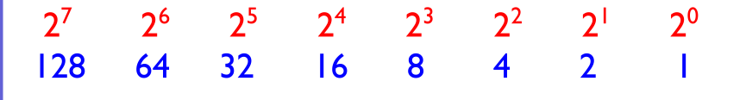
Convert denary 25 into binary
0 0 0 1 1 0 0 1

Slide 7
Convert denary 69 into binary
0 1 0 0 0 1 0 1

Slide 8
Convert 10110001 into base 10
1 0 1 1 0 0 0 1
128+32+16+1 = 177

Slide 9
Convert 01010101 into denary
0 1 0 1 0 1 0 1
64+16+4+1= 85

Slide 10
Fill in the blanks
Computers use a base 2 number system called Binary. It only uses 1 and 0.
Decimal is a base 10 number system. It is also called denary. It uses the numbers 0,1,2,3,4,5,6,7,8,9
Hexadecimal is base 16. It uses 0,1,2,3,4,5,6,7,8,9,A,B,C,D,E and F

Slide 11
Hexadecimal
Hexadecimal uses base 16.
0,1,2,3,4,5,6,7,8,9,A,B,C,D,E and F
Why??

Slide 12
What is A-F in Hex?
Binary | Denary | Hex
Base 2 | Base 10 | Base 16
0000 | 0 | 0
0001 | 1 | 1
0010 | 2 | 2
0011 | 3 | 3
0100 | 4 | 4
0101 | 5 | 5
0110 | 6 | 6
0111 | 7 | 7
1000 | 8 | 8
1001 | 9 | 9
1010 | 10 | A
1011 | 11 | B
1100 | 12 | C
1101 | 13 | D
1110 | 14 | E
1111 | 15 | F

Slide 13
So what?
Hex does NOT let you count higher, it lets you read large numbers easier.
Lets say you have an 8 bit computer.
It will range from:
0000 0000 (zero, zero)
0001 0001 (one, one)
0010 0010 (two, two)
I’ll skip some
1010 1010 (ten, ten)
1011 1011 (eleven, eleven)
All the way to…
1111 1111 (fifteen, fifteen)

Slide 14
The highest number that can be held
Binary | Denary | Hex
Base 2 | Base 10 | Base 16
0000 0000 | 0, 0 | 0 ,0
0001 0001 | 1, 1 | 1, 1
0010 0010 | 2, 2 | 2, 2
I’ll skip some
1010 1010 | 10, 10 | A, A
1011 1011 | 11, 11 | B, B
All the way to
1111 1111 | 15, 15 | F, F

Slide 15
The highest number
1 1 1 1 1 1 1 1
128+64+32+16+8+4+2+1 = 255
or
FF or FF₁₆ or FF_{x}

Slide 16
But….
Computers are not 8-bit.
Even an iPhone 5s is 64bit
then 64bit is:
1111,1111 1111,1111 1111,1111 1111,1111 1111,1111 1111,1111 1111,1111 1111,1111
or in Hex, its just:
FF, FF, FF, FF, FF, FF, FF, FF
In Decimal its equals:
9,223,372,036,854,775,807 or nine quintillion two hundred twenty three quadrillion three hundred seventy two trillion thirty six billion eight hundred fifty four million seven hundred seventy five thousand eight hundred and seven
You see how quicker it is to say the Hex value.

Slide 17
Convert 1D8 Hex to Denary
1 D 8
1 * 256 = 256
D * 16 = ???
8 * 1 = 8
1 * 256 = 256
* 16 = 208
* 1 = 8
256 + 208 + 8 = 472

Slide 18
Convert 3ABC Hex to Denary
3 A B C
3 * 4096
A * 256
B * 16
C * 1
3 * 4096 = 12,288
10 * 256 = 2560
11 * 16 = 176
* 1 = 12
12,288 + 2560 + 176 + 12 = 15036

Slide 19
Its easy but you may need a calculator
Non calculator method.
Every Hex digit is 4 binary bits
This method Hex -> Binary -> Denary

Slide 20
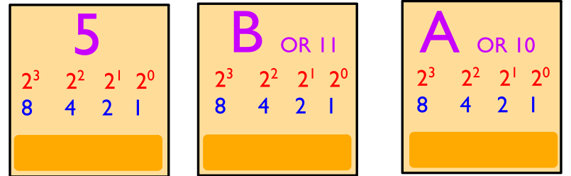
5BA to Binary
0 1 0 1
1 0 1 1
1 0 1 0

Slide 21
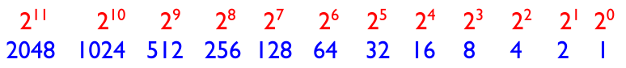
Then convert that binary like before
0 1 0 1 1 0 1 1 1 0 1 0
1024 + 256 + 128 + 32 + 16 + 8 + 2 = 1466
So
5BA = 0101 1011 1010 = 1466

Slide 22
Task
Get some paper
Write down any hex number on it
Give it to someone
That person must convert your hex into binary and denary.
No calculators

Slide 23
Decimal to Hex
Convert 456 into Hex
You must divide
256 / 456 = 1 remainder of 200
16 / 200 = 12 remainder of 8
1 / 8 = 8 remainder of 0
12 8
1 C 8

Slide 24
But that is hard and stupid
You need a calculator for that method.
Decimal to Hex is better if you do:
Decimal to binary
Binary to hex

Slide 25
97
What is 97 decimal in Hex?
Find the binary
0 1 1 0 0 0 0 1

Slide 26
97
Now remember every hex digit is 4 binary bits long
0 1 1 0 0 0 0 1

Slide 27
97
And now just convert like normal
0 1 1 0 0 0 0 1
0 1 1 0
0 0 0 1
61

Slide 28
Task
Get some paper
Write down any hex, denary or binary number
Give it to someone
That person must convert your number into the different number systems.
No calculators

Slide 29
Today
3. Perform binary addition and subtraction
Understand: The rules of addition and subtraction
Able : Add and Subtract Binary
Answer: What are the difference between signed magnitude, one complement and two’s complement

Slide 30
Question
Using 4 bits, in Binary, what is decimal 5?
0011
Oh, you feel smart huh, okay…. What is negative 3 (-3) ?
You cant have -0011 because there is no ”-” symbol in binary, all we have is 0 and 1.
So, there are 3 ways we deal with negative numbers. The first two ways are stupid, but the third way is the one we use. But we should know all 3 ways.
Signed Magnitude (Very stupid way)
One’s Complement (Still stupid)
Two’s Complement (it’s okay)

Slide 31

Binary Addition
Before we do the 2 stupid ways and one okay way, we need to know how to add in binary.

Slide 32
Binary Addition
0 + 0 = 0 (decimal 0)
0 + 1 = 1 (decimal 1)
1 + 0 = 1 (decimal 1)
1 + 1 = 0 carry 1 (decimal 2)
1 + 1 + 1 = 1 carry 1 (decimal 3)
Why for decimal 2, which is written as 1 0 in Binary, why do I use the 0 and carry the 1 and not use 1 and carry the 0.
You do the same for decimal addition 5 + 7 = 12 But if you was to write it, you would do:
 | 5
 | 7
1 | 2

Slide 33
Negative Numbers
Lets go back and look at the three ways to use negative numbers.
Signed Magnitude (Very stupid way)
One’s Complement (Still stupid)
Two’s Complement (it’s okay)

Slide 34
Signed Magnitude
Signed Magnitude is the simplest method. But it doesn’t work.
It takes the most significant bit (which is always the one on the left) and it says:
“If the bit on the left is 0 then everything else is positive. If the bit on the left is a 1, then everything else is negative”
So
0 | 0 | 1 | 1 | Standard Binary positive 3
0 | 0 | 1 | 1 | Signed Magnitude positive 3
1 | 0 | 1 | 1 | Signed Magnitude negative 3

Slide 35
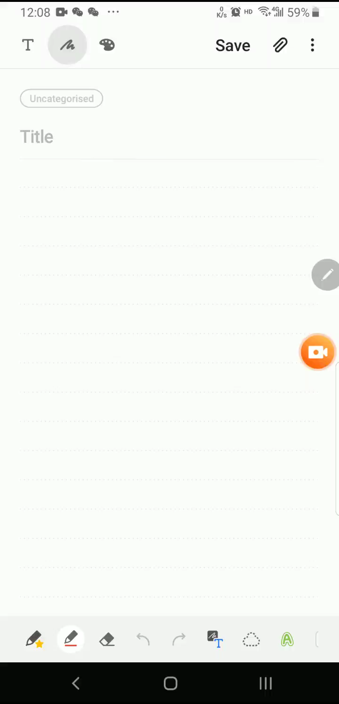
So why is Signed Magnitude stupid?
So in Signed Magnitude,
Positive 3 = 0011
Negative 3 = 1011
So lets add positive 3 with negative 3.
Our answer should be neutral 0

Slide 36
That’s why signed magnitude is stupid
Binary | Signed Magnitude
Base 2 | Base 10
0000 | 0
0001 | 1
0010 | 2
0011 | 3
0100 | 4
0101 | 5
0110 | 6
0111 | 7
1000 | -0
1001 | -1
1010 | -2
1011 | -3
1100 | -4
1101 | -5
1110 | -6
1111 | -7
Because it doesn’t work!
It’s a simple idea: The bit on the left is your signed bit
0 = positive
1 = negative
But when you add numbers together it fails.
AND have a look at the table.
There are two 0’s. Positive 0 (0000) and negative 0 (1000)

Slide 37
One’s Complement
So another method was made, called One’s Complement.
It’s a way to find out a negative number.
You know if it’s a negative number because the sign bit (the bit on the left, if it’s a 0 then positive and if its 1 then its negative)
Find the positive
Flip the 0’s and 1’s and that’s the negative version
So positive 3 = 0 0 1 1
Flip it = 1 1 0 0 That’s negative 3 in one’s complement
Again
Positive 5 = 0 1 0 1
Flip it = 1 0 1 0 That’s negative 5 in one’s complement

Slide 38
One’s Complement
Binary | Denary | Binary | Denary
Base 2 |  | One’s Complement
0000 | 0 | 1111 | -0
0001 | 1 | 1110 | -1
0010 | 2 | 1101 | -2
0011 | 3 | 1100 | -3
0100 | 4 | 1011 | -4
0101 | 5 | 1010 | -5
0110 | 6 | 1001 | -6
0111 | 7 | 1000 | -7
1000 | 8 | 0111 | 7
1001 | 9 | 0110 | 6
1010 | 10 | 0101 | 5
1011 | 11 | 0100 | 4
1100 | 12 | 0011 | 3
1101 | 13 | 0010 | 2
1110 | 14 | 0001 | 1
1111 | 15 | 0000 | 0
Because lets say positive 1 = 0 0 0 1 Flip it to find the negative 1 = 1 0 0 0
So we can find -1 as one’s complement.
What about 0 then?
Normal 0 is 0 0 0 0
Flip it and its 1 1 1 1
0000 in one’s complement is positive 0 decimal
But we already have 1111 in one’s complement which is negative 0
We still have +0 and -0

Slide 39
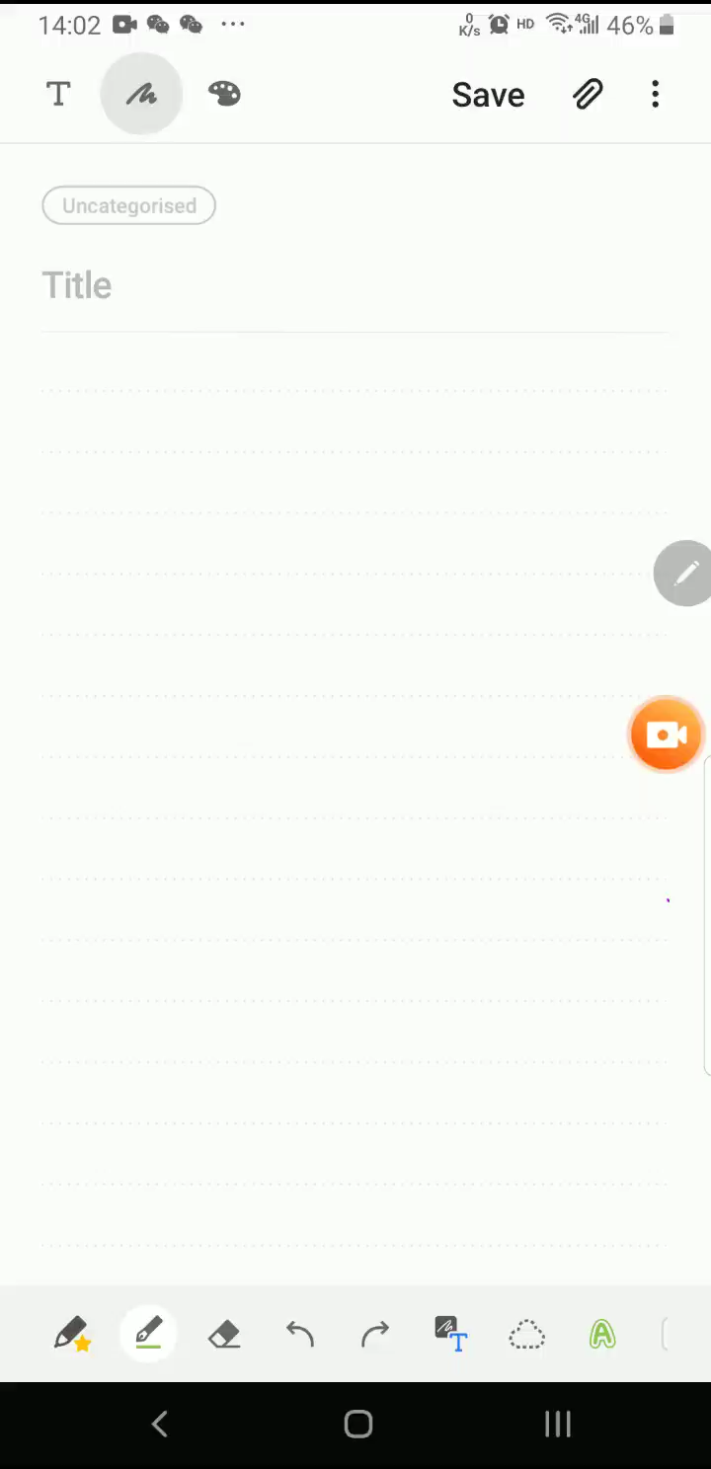
One’s Complement
Let’s do our example: positive 3 plus negative 3 to equal neutral 0
So no matter what we do, one’s complement is wrong
If we keep our answer in one’s complement it becomes negative 0. There is no such thing
If we switch it back to signed magnitude then its negative 7. Not even close to our answer

Slide 40
Two’s Complement
So another method to find negative numbers was made.
Two’s Complement
Find the positive
Flip the values
Add 0 0 0 1
Part (a) and (b) are the same as one’s complement, we are now just adding 1
Example: Positive 6 = 0 1 1 0
Flip it = 1 0 0 1
Add 0001 = 0 0 0 1
Answer = 1 0 1 0
So negative 6 in two’s complement is 1 0 1 0

Slide 41
Two complement
Binary | Denary | Binary | Denary | Binary | Denary
Base 2 |  | One’s Complement |  | Two’s Complement
0000 | 0 | 1111 | -0 | 10000 | 0
0001 | 1 | 1110 | -1 | 1111 | -1
0010 | 2 | 1101 | -2 | 1110 | -2
0011 | 3 | 1100 | -3 | 1101 | -3
0100 | 4 | 1011 | -4 | 1100 | -4
0101 | 5 | 1010 | -5 | 1011 | -5
0110 | 6 | 1001 | -6 | 1010 | -6
0111 | 7 | 1000 | -7 | 1001 | -7
1000 | 8 | 0111 | 7 | 1000 | -8
1001 | 9 | 0110 | 6 | 0111 | 7
1010 | 10 | 0101 | 5 | 0110 | 6
1011 | 11 | 0100 | 4 | 0101 | 5
1100 | 12 | 0011 | 3 | 0100 | 4
1101 | 13 | 0010 | 2 | 0011 | 3
1110 | 14 | 0001 | 1 | 0010 | 2
1111 | 15 | 0000 | 0 | 0001 | 1
So here you can see we take the original binary, flip it to get One’s complement and then add 1 to get Two’s complement.
We only have one 0
Which is 1 0 0 0 0
But this has an extra 1, we will deal with this soon.

Slide 42

Let’s try our addition
Positive 3 add Negative 3
Find positive 3 0 0 1 1
Flip it 1 1 0 0
Add 0001 0 0 0 1
So -3 in 2C is 1 1 0 1
Now just do the math
Positive 3 0 0 1 1
Two Comp -3 1 1 0 1
Answer 1 0 0 0 0
We will deal with that extra ‘1’ in a moment

Slide 43
That extra 1 on the left
So our answer is:
Positive 3 0 0 1 1
Two Compliment -3 1 1 0 1
Answer 1 0 0 0 0
But it has an extra 1 on the left.
We are only using 4 bits, but our answer has 5 bits.
We remove this extra 1 on the left and just keep the four zeros. So 1 0 0 0 0 becomes 0 0 0 0
This extra 1, this is called our OVERFLOW.

Slide 44

Okay here is something annoying.
Your syllabus says:
“Perform binary addition and subtraction”
Binary addition we done, but for binary subtraction…. It doesn’t say if it should be done in normal binary or two’s complement binary
So we will do both ways. So happy!!
NARY

Slide 45
Normal Binary Subtraction
Rules:
0 – 0 = 0
1 – 0 – 1
0 – 1 = 1 (but you need to take 1 from the left column to make it 1 0 – 1)
1 – 1 = 0

Slide 46

Normal Binary Subtraction

Slide 47
Binary Subtraction using Two’s Complement
So happy….
Because two’s complement is already the way to show negative numbers, then we just do binary addition with our negative number.
Just remember the addition rules
0 + 0 = 0
0 + 1 = 1
1 + 0 = 1
1 + 1 = 0 carry 1
1 + 1 + 1 = 1 carry 1
The next video does the same steps and the same answer, I just don’t like the way he carries.

Slide 48


Slide 49
Today
4. Describe practical applications where Binary Coded Decimal (BCD) and Hexadecimal are used
5. Show understanding of and be able to represent character data in its internal binary form, depending on the character set used
Understand : What is ASCII and BCD
Able : Decode ASCII
Answer : What alternatives are there?

Slide 50
ASCII
ASCII is American Standard Code for Information Interchange
It is a code to represent English letters, numbers and characters.

Slide 51
How can you and a computer communicate?
You cannot speak binary...so what happens?

Slide 52
Standard ASCII code is made up of 7 bits.
2⁷
2⁷ bits mean you can have 128 characters (including 0)
Standard ASCII is split up into 2 sections:
Non Printable - System codes like ESC, ENTER - these are between 0 -31
Printable - from 32- 127

Slide 53
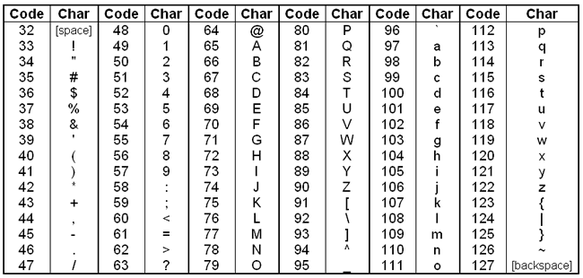
Non Printable

Slide 54
Printable
So if you the word Cat
Its 67, 97, 116
1000011 1100001 1110100

Slide 55
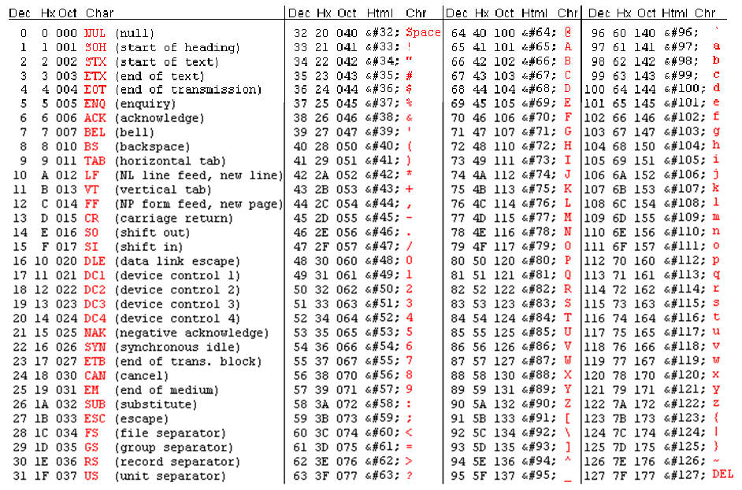
What are your initials in Binary?

Slide 56
I lied....(kind of...)
Standard ASCII code does have 128 characters (printing and system combined) - 2⁷
But there is also Extended ASCII.
Extended ASCII has 2⁸ - 256 characters (including 0)
Extended ASCII allows for extra characters, symbols and support for other languages!!

Slide 57
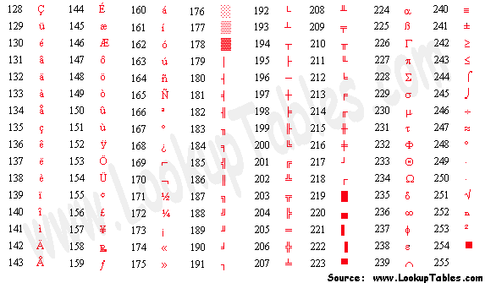
Extended ASCII

Slide 58
Quick Quiz
1. What language does a computer understand?
2. What does the abbreviation ASCII stand for?
3. How many bits does standard ASCII use?
4. How many characters does this mean standard ASCII has?
5. Standard ASCII is broken up into two sections - what are these?
6. The first ???? codes in ASCII are system codes
7. Convert 97 into binary
8. Convert 01100001 into denary
9. How many bits does extended ASCII use?
10. How many characters does extended ASCII have?
11. What benefit does Extended ASCII allow for?

Slide 59
Question
Do you think that Extended ASCII has enough characters for everything you need?
Unicode
Unicode has a code for every character in many different languages.
Unicode doesn't tell you what the binary for a letter is, it just says A=65, or B=66 or Д = 414

Slide 60
Problem ((
Lets take that letter Д at Unicode point 414.
In binary it will be: 0000000110011110
That's a lot of 0's before you actually get to anything useful.
This takes up a lot of space.
Some computers, if they read 0000 0000 (eight zeros) they terminate the program
So something else was invented as part of Unicode
It's called Unicode Transformation Format or UTF
There have been many UTFs, UTF-2, UTF-8, UTF-16... the most common is UTF 8.

Slide 61
Remember 0000000110011110 for the letter Д and it had all those extra 0s.
Well UTF-8 was designed like to avoid this.
If you have something like the letter A, which can be written in ASCII then you start UTF-8 with the number 0 and then the rest of the code as normal ASCII.
So A in UTF-8 =
01000001
UTF-8 ASCII
But what about out letter Д with the binary of 0000000110011110

Slide 62
With UTF-8 if you need something that's in the ASCII table you start with 0.
Otherwise you start with 110 and will need 10 also
The 11 in 110 tell you it will be two bytes long (two ones mean two bytes) each byte is 8 characters.
So you have 110xxxxx and then you have 10xxxxxx
The 10 just tells the computer its a continuation from the previous byte and now you just fill the x's with the actual binary. So our Д was 0000000110011110 but in UTF-8 it will be:
11000110 10011110
We have 11 little x's so we use those 11 bits from the binary code.
When you send this to another computer, the other computer takes off the UTF-8 code (110 and 10) and you are left with 00110011110 or the letter Д

Slide 63
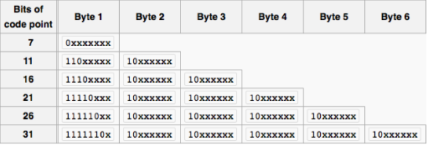
Here you see if you start with 0 then you have 7 bits to fill to make 1 byte. That is 2⁷ and gives you 128 characters (ASCII)
If you start with 110, it means you have 2 bytes and you need to have eleven bits to fill. 2¹¹ which is 2048 characters
1110 means 3 bytes (three 1's) and that gives you 16 bits to fill and that's 2¹⁶ which allows 65,536 characters.
All the way to 1111110, means 6 bytes and 31 bits to fill. 2³¹ is 2,147,483,648 characters

Slide 64
Today
Understand : What is BCD
Able: To write BCD
Answer : Why we use BCD

Slide 65
BCD
BCD = Binary Coded Decimal
Another way to show numbers
Always has 4 bits
The easiest thing ever

Slide 66
BCD
What is 0 in Binary?
0
What if I wanted 0 expressed as a 4 bit number?
0000

Slide 67
BCD
What about 1 in binary as 4 bits?
0001
And 2
0010

Slide 68
BCD
Binary | Denary
Base 2 | Base 10
0000 | 0
0001 | 1
0010 | 2
0011 | 3
0100 | 4
0101 | 5
0110 | 6
0111 | 7
1000 | 8
1001 | 9
1010 | 10
1011 | 11
1100 | 12
1101 | 13
1110 | 14
1111 | 15
In BCD, you look at the decimal number and make it 4 bits.
If you get a 2 digit number – like 15
In Binary you write 1111
In BCD you write 0001 0101
(its 1 then 5)

Slide 69
BCD Example
If you wanted 27 in BCD
Its 2 then 7
or
0010 0111
982 is 9 then 8 then 2
or 1001 1000 0010

Slide 70
Task
Convert these from / to BCD
18
93
10384
1001 1100 (BCD)
1110 0001 (BCD)
31278
833201
0110 0011(BCD)

Slide 71
Can you
Look at:
1001 1100 (BCD)
1110 0001 (BCD)
Question 1’s answer is 9 and 12
Question 2 is 14 and 1
Can you have 12 and 14 as valid answers? Because you should only have 1 digit in BCD, you can have the numbers 0 – 9 only

Slide 72
Why use BCD?
Used in some early computers
Easier for humans to decode
Used in financial applications to avoid rounding errors
Digital clocks use BCD. You’re not looking at 11:35 you are looking at 1,1, : 3 and 5

Slide 74
Remember when we did this…..
1 bit = 1 binary digit = the smallest thing you can have
1 byte = 8 bits
1 kilobyte = 1024 bytes
1 megabyte = 1024 kilobytes
1 gigabyte = 1024 megabytes
…
Bit > Byte > Kilobyte > Megabyte > Gigabyte > Terabyte > Petabytes > Exabyte > Zettabyte > Yottabytes > Brontobyte > Geopbyte

Slide 75
Well there is a problem….
Question: How many meters are in a kilometre (km)?
Answer: 1000
Question: How many grams are in a kilogram (kg)?
Answer: 1000
So why is kilobyte 1024 and not 1000?
Okay….. This next part is nonsense, but stay with me….
Cambridge wants us to use some new words. These new words were made by the IEC, International Electrotechnical Commission
And no one….no one….no one uses these new words, but we need to do them because Cambridge says so

Slide 76
ICE Sizes
The IEC wants to keep everything as 1000 not 1024. So it goes:
1 bit
1 nibble = 4 bits
1 byte = 2 nibbles = 8 bits
1 kilobyte (kb) = 1000 bytes
1 megabyte (mb) = 1000 kb
1 gigabyte (gb) = 1000 mb
1 terabyte (tb) = 1000 gb
1 petabyte (pb) = 1000 tb
1 exabyte (eb) = 1000 pb
And now we have another problem…. Because everyone still thinks kilobyte is 1024 and not 1000 like the IEC wants.
So when someone says kilobyte does it mean 1000 bytes like the IEC wants or does it mean 1024 bytes like everyone thinks?
Notes:
Petabytes > Exabyte

Slide 77
IEC Terms
So because of this confusion the IEC wants us to learn these new words
1 bit
1 nibble = 4 bits
1 byte = 8 bits
1 Kibibyte (KiB) = 1024 bytes
1 Mebibyte (MiB) = 1024 Kibibyte
1 Gibibyte (GiB) = 1024 Mebibyte
1 Tebibyte (TiB) = 1024 gibibyte
1 Pebibyte (PiB) = 1024 tebibyte
1 Exbibyte (EiB) = 1024 pebibyte
1 Zebibyte (ZiB) = 1024 exbibyte
1 Yobibyte (YiB) = 1024 zebibyte

Slide 78
All terms
So these are all the IEC terms. But remember, every book, website, even in our lessons ignore the IEC. But we need it for our exams
IEC Terms
1 bit |  |  | 1 bit
1 nibble | 4 bits |  | 1 nibble | 4 bits
1 byte | 8 bits |  | 1 byte | 8 bits
1 kilobyte (kb) | 1000 bytes |  | 1 Kibibyte (KiB) | 1024 bytes
1 megabyte (mb) | 1000 kilobyte (kb) |  | Mebibyte (MiB) | 1024 Kibibyte (KiB)
1 gigabyte (gb) | 1000 megabyte (mb) |  | 1 Gibibyte (GiB) | 1024 Mebibyte (MiB)
1 terabyte (tb) | 1000 gigabyte (gb) |  | 1 Tebibyte (TiB) | 1024 gibibyte (GiB)
1 petabyte (pb) | 1000 terabyte (tb) |  | 1 Pebibyte (PiB) | 1024 tebibyte (TiB)
1 exabyte (eb) | 1000 petabyte (pb) |  | 1 Exbibyte (EiB) | 1024 pebibyte (EiB)
Notes:
Petabytes > Exabyte

Slide 79
Your syllabus
Your syllabus says:
Calculate the file size of an image file and a sound file, using information given
Information given may include:
– image resolution and colour depth
– sound sample rate, resolution and length of track
Well, we did all of that in 1.2 Text, Sound and Images.
So we can now move onto Compression

